Slide 1

ENTERPRISE SOFTWARE DEVELOPMENT

Slide 2
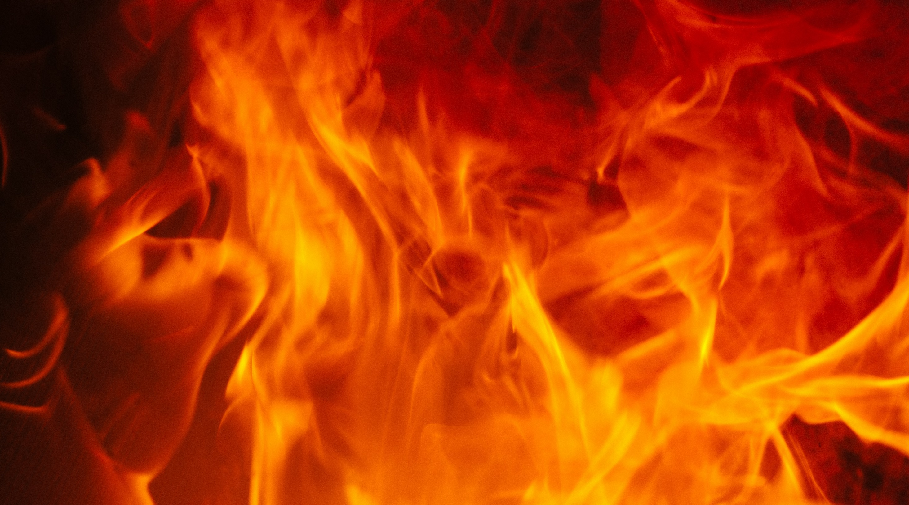
SSW FireEmoji The perfect gitmoji for every commit Team AI: JK, Jayden, Brady, Tylah (Better than Team A)

Slide 3
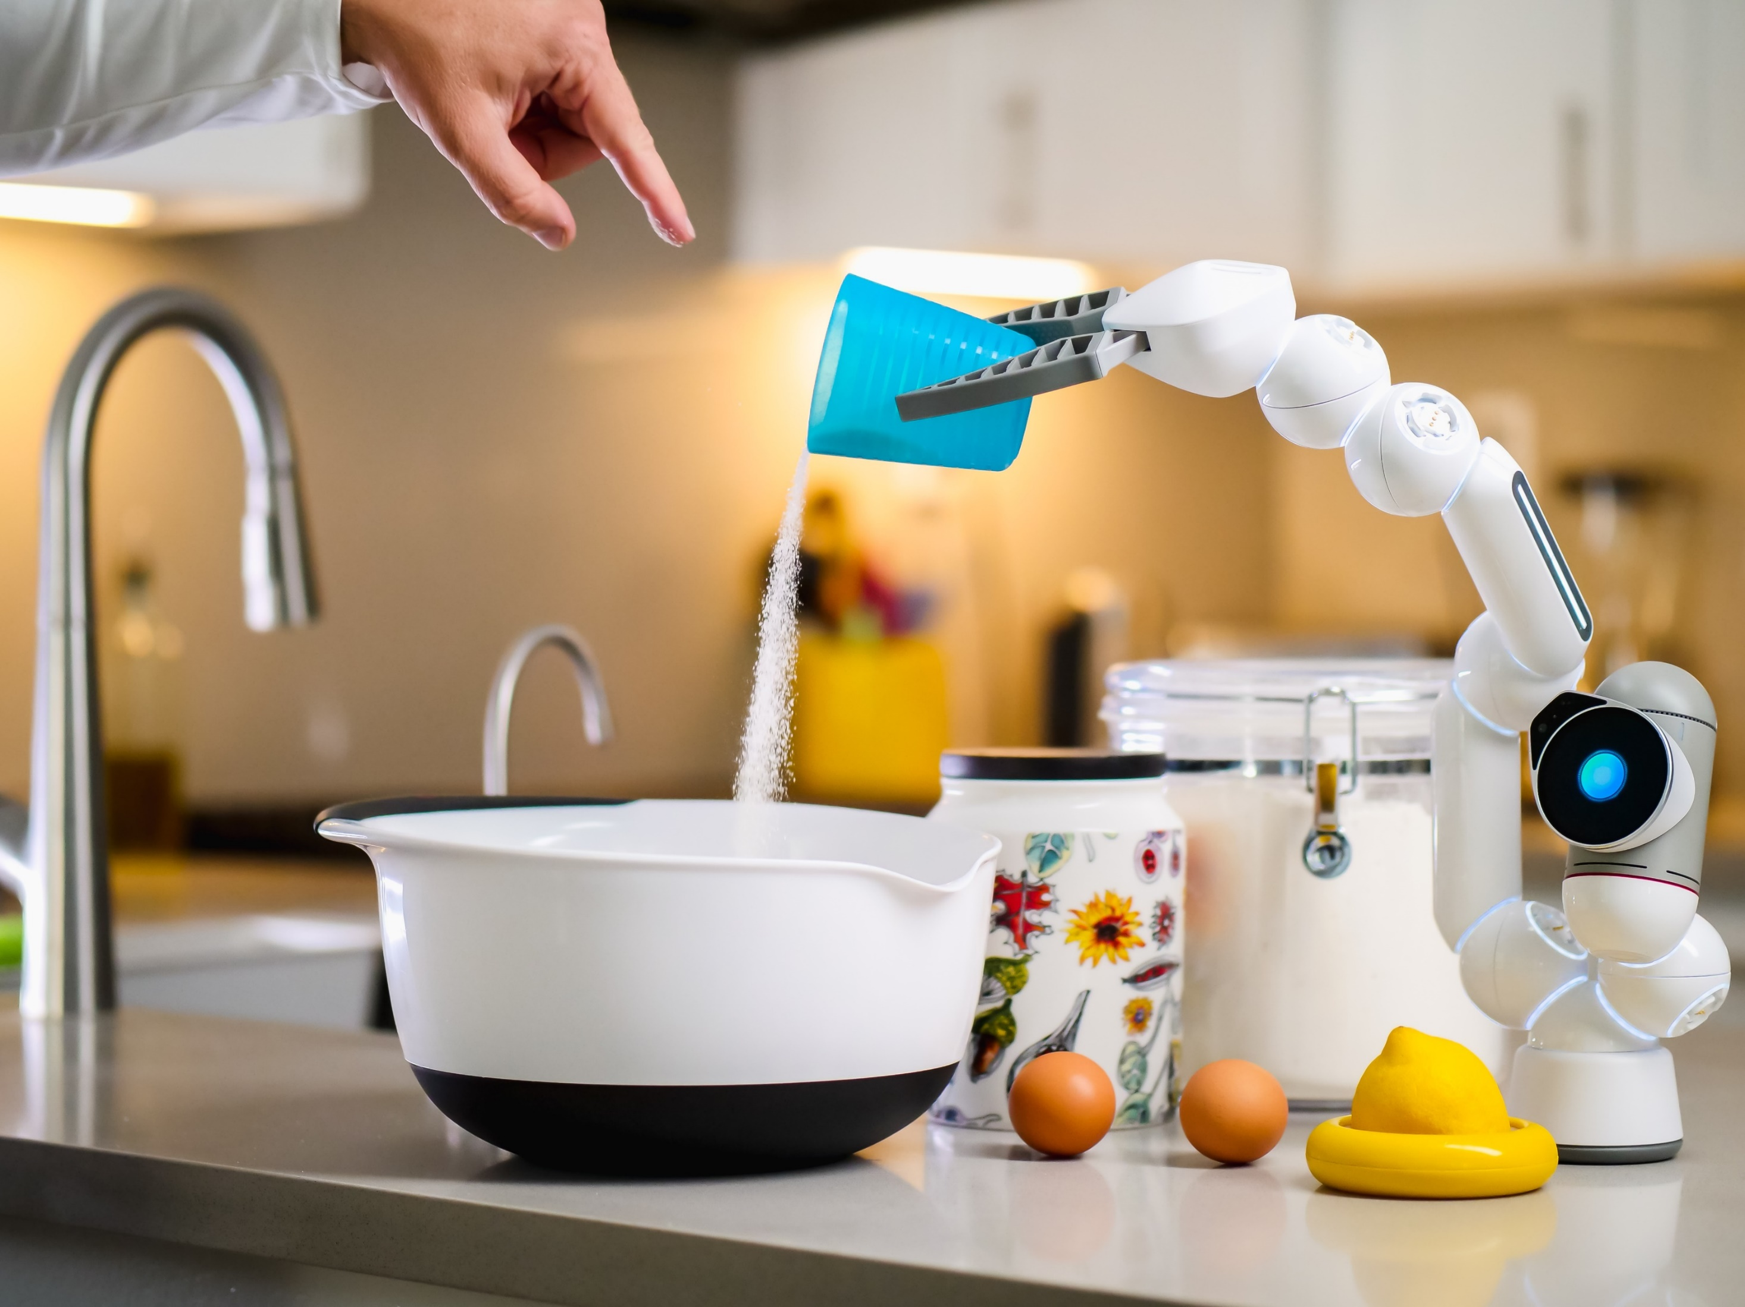

From Data to AI: Quickly create Machine Learning with ML.NET
V2
AI Hack Day Warm-up 2022

Slide 4








Jernej Kavka (JK)
SSW Solution Architect
@Jernej_kavka
github.com/jernejk
jkdev.me
linkedin.com/in/jernejkavka/
Organizer of AI events
.NET Core and EF Core dev specialist
Cognitive Services and ML․NET enthusiast🦸‍♂️

Slide 5
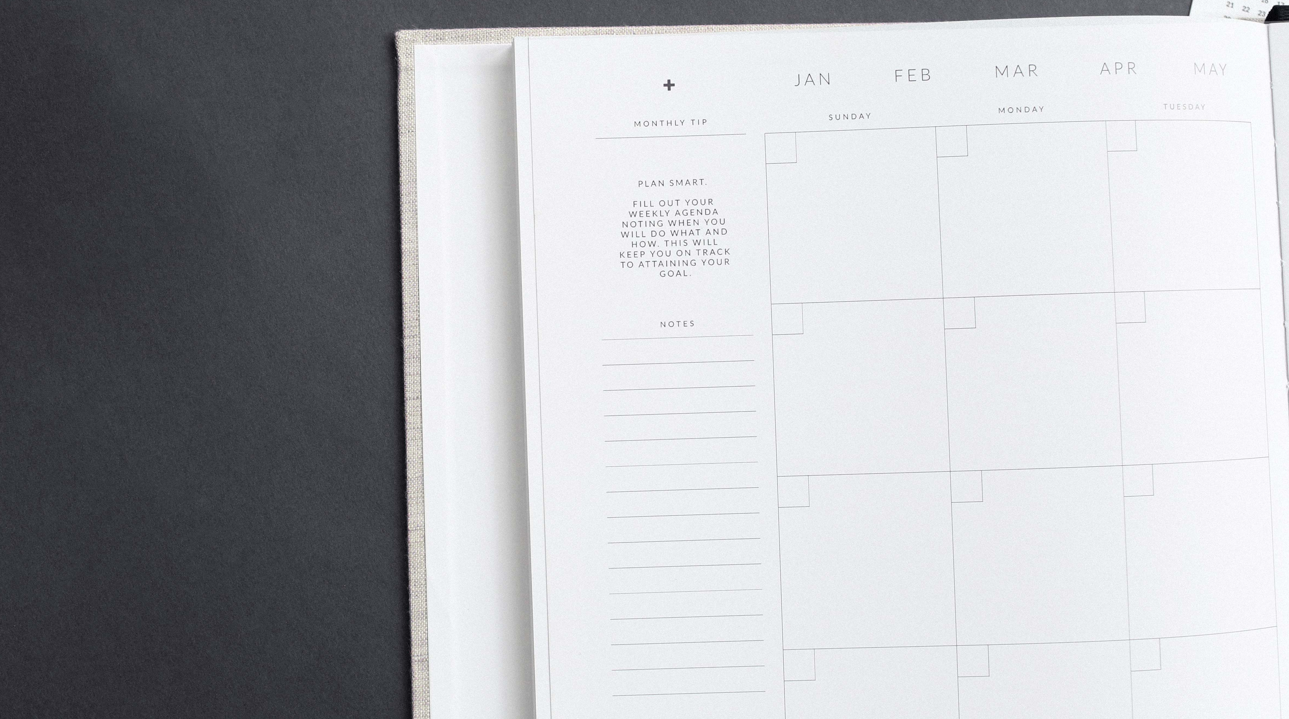

Agenda
1. What is Machine Learning (90 seconds edition)
2. What is ML.NET Model Builder
3. Example 1: Gitmojis (SSW.FireEmoji)
4. Example 2: Classifying bank transactions
5. Summary

Slide 6
Agenda
1. What is Machine Learning (90 seconds edition)
2. What is ML.NET Model Builder
3. Clever gitmojis - SSW.FireEmoji 🔥

Slide 7
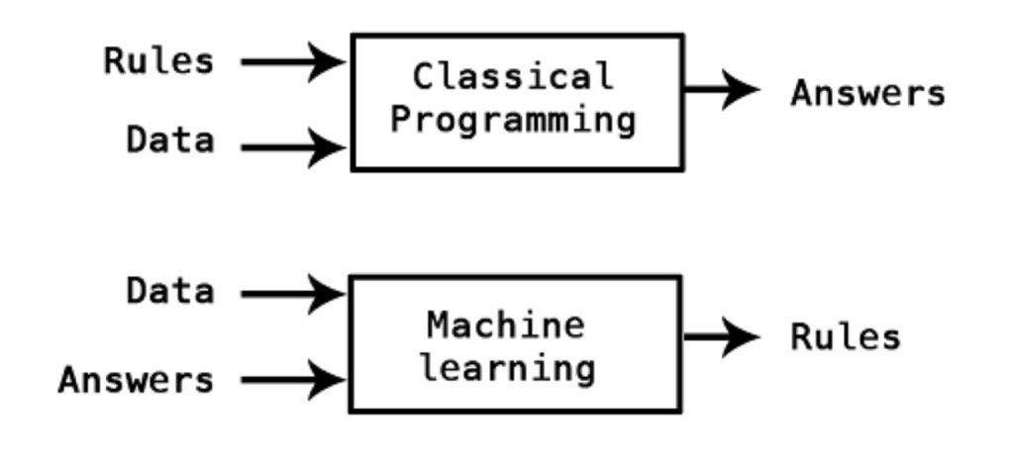
What is Machine Learning? (90 seconds edition)

Slide 8
Rock, Paper, Scissors (classic)
If rock then paper
If paper then scissors
If scissors then rock

Slide 9
Rock, Paper, Scissors (ML)
Opponent | Winner
Rock | Paper
Paper | Scissors
Rock | Paper
Scissors | Rock
… | …

Slide 10
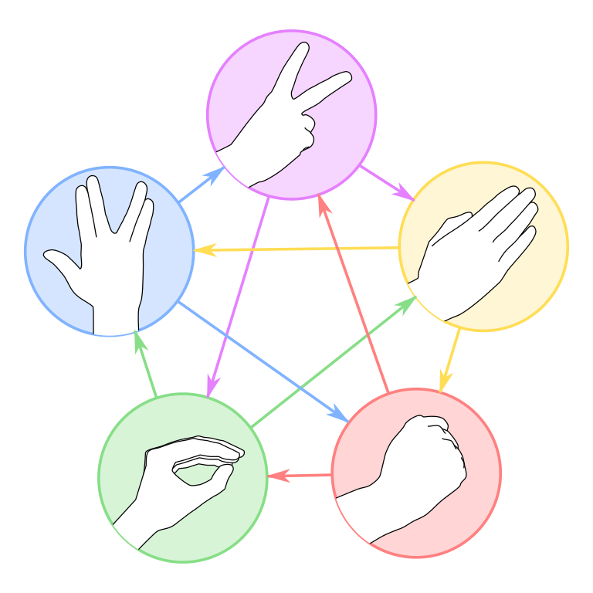
Rock, Paper, Scissors, Lizard, Spock (ML)
Opponent | Winner
Rock | Paper
Paper | Scissors
Rock | Paper
Scissors | Rock
Lizard | Rock
Spock | Lizard
Scissors | Spock
Paper | Lizard
… | …

Slide 11

What is ML.NET Model Builder
ML.NET is a C# SDK for Machine Learning
Model Builder is a Visual Studio and VS Code extension
✅ Is easy to use
✅ Allows quick prototyping
✅ Has many scenarios built in

Slide 12
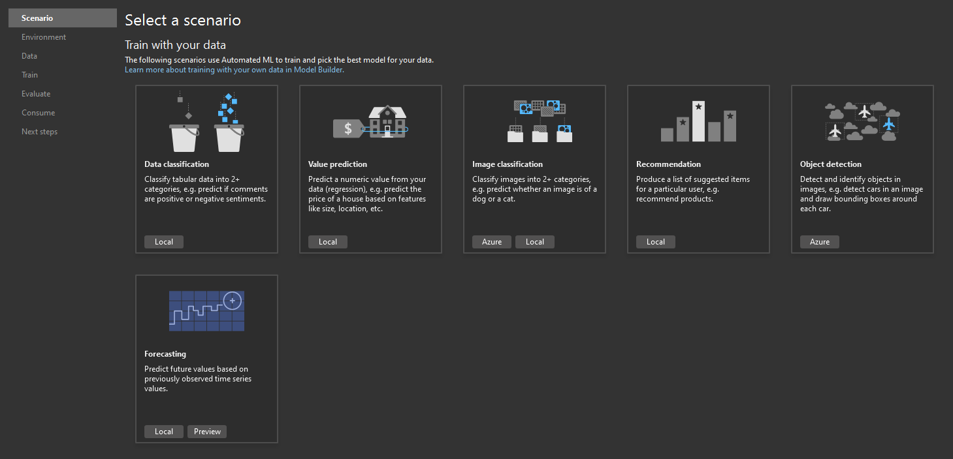
ML.NET Model Builder

Slide 13
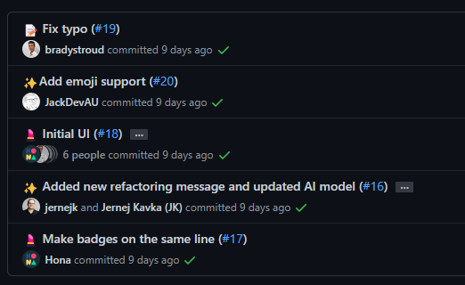
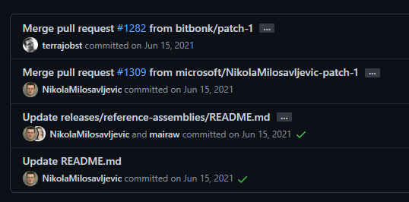
What is gitmoji?
See README.MD and PRs
2 UI fixes 💄, 2 new features ✨ and 1 typo fix 📝

Slide 14

What is the Problem?
❌ Not every git user knows how to use them
❌ Vague descriptions, no examples
❌ 69 official gitmojis
❌ Finding the right emoji can be hard
❌ No consistency

Slide 15

Solution (AI)
Use ML to determine the correct gitmoji
User suggestions create improvements
✅ Learns over time

Slide 16
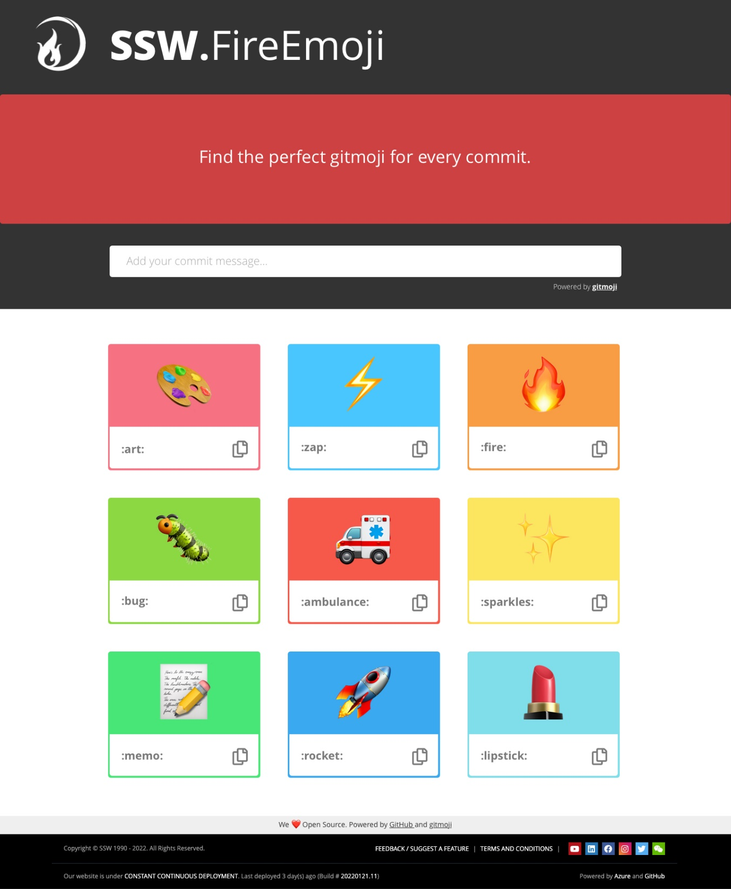
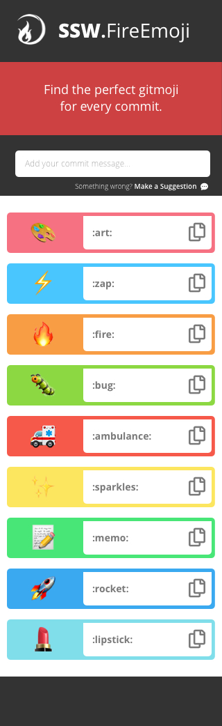

Slide 17
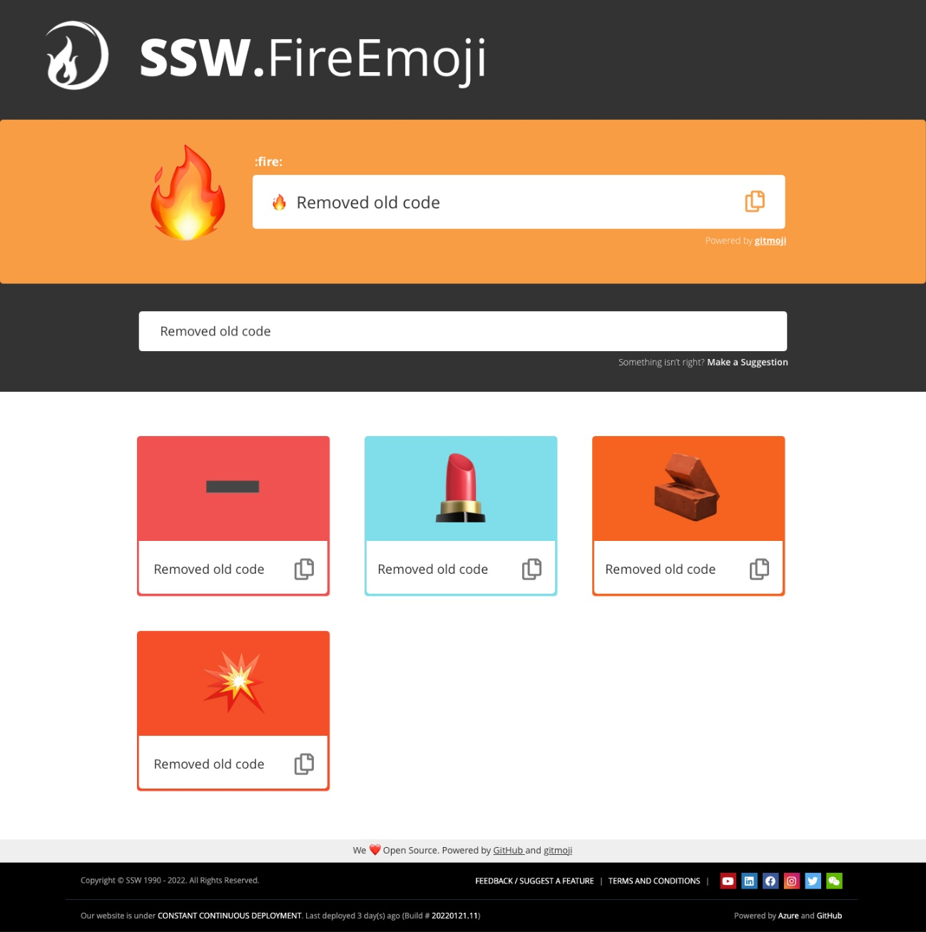
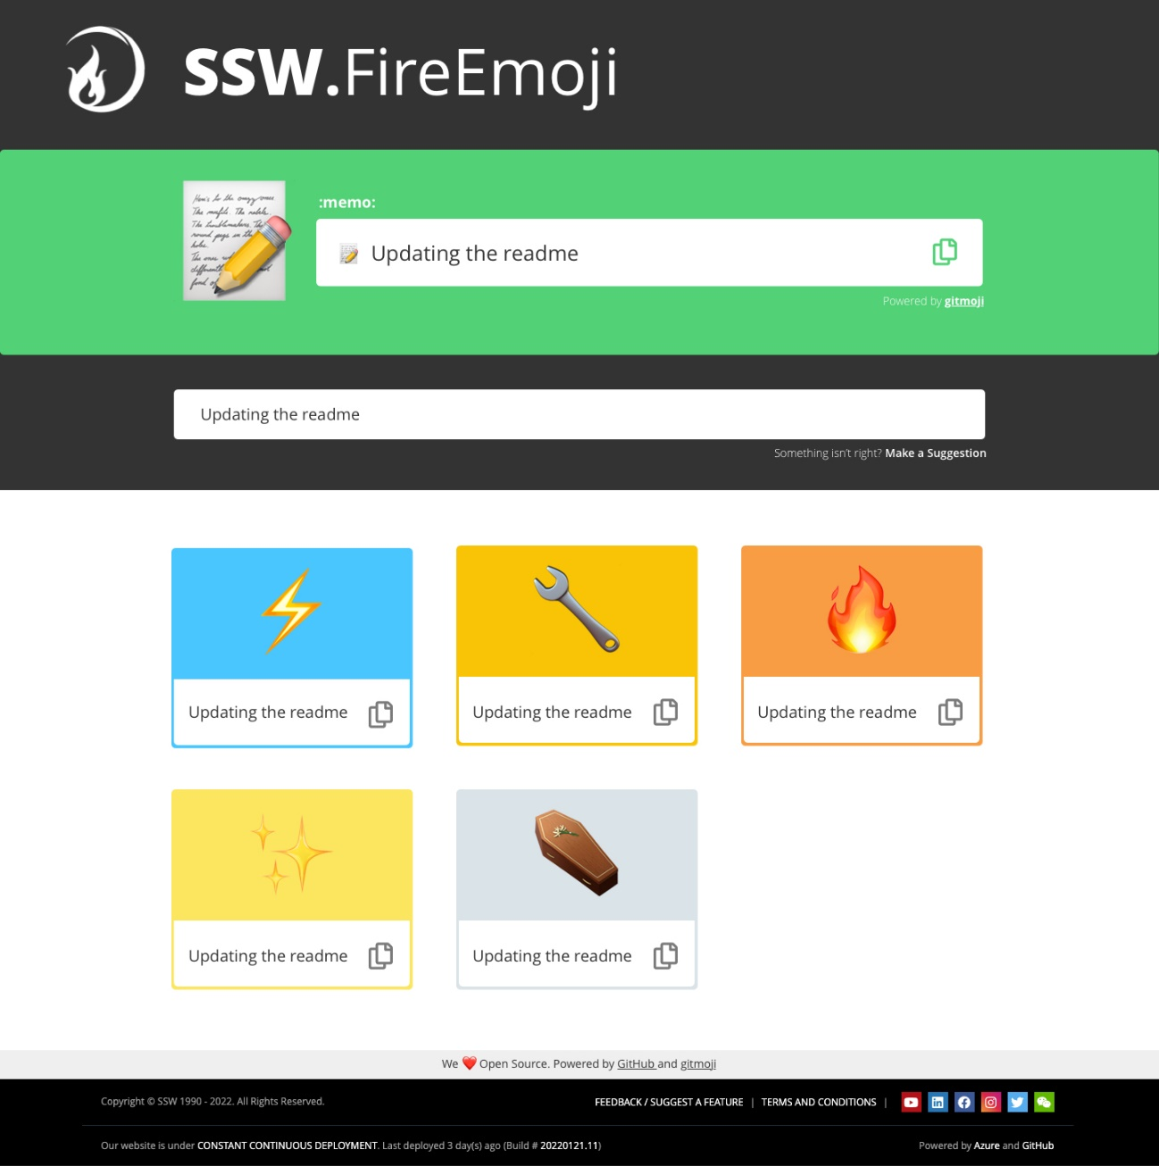
www.fireemoji.io | Clever gitmojis

Slide 18

Prototyping SSW.FireEmoji 🔥
Notes:
https://www.ssw.com.au/rules/rules-to-better-powerpoint-presentations

Slide 19
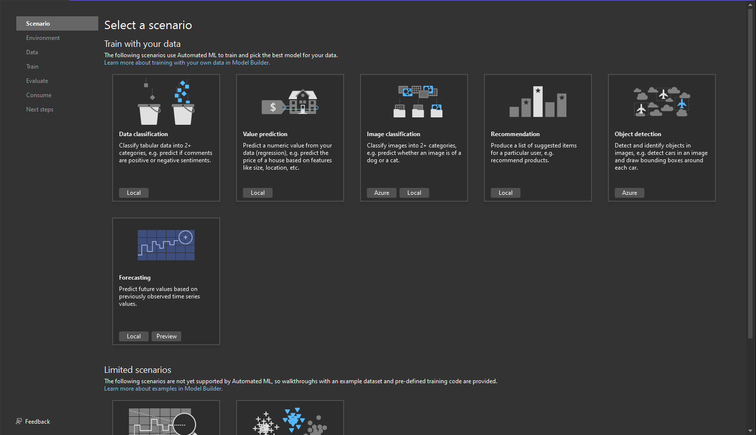

Slide 20
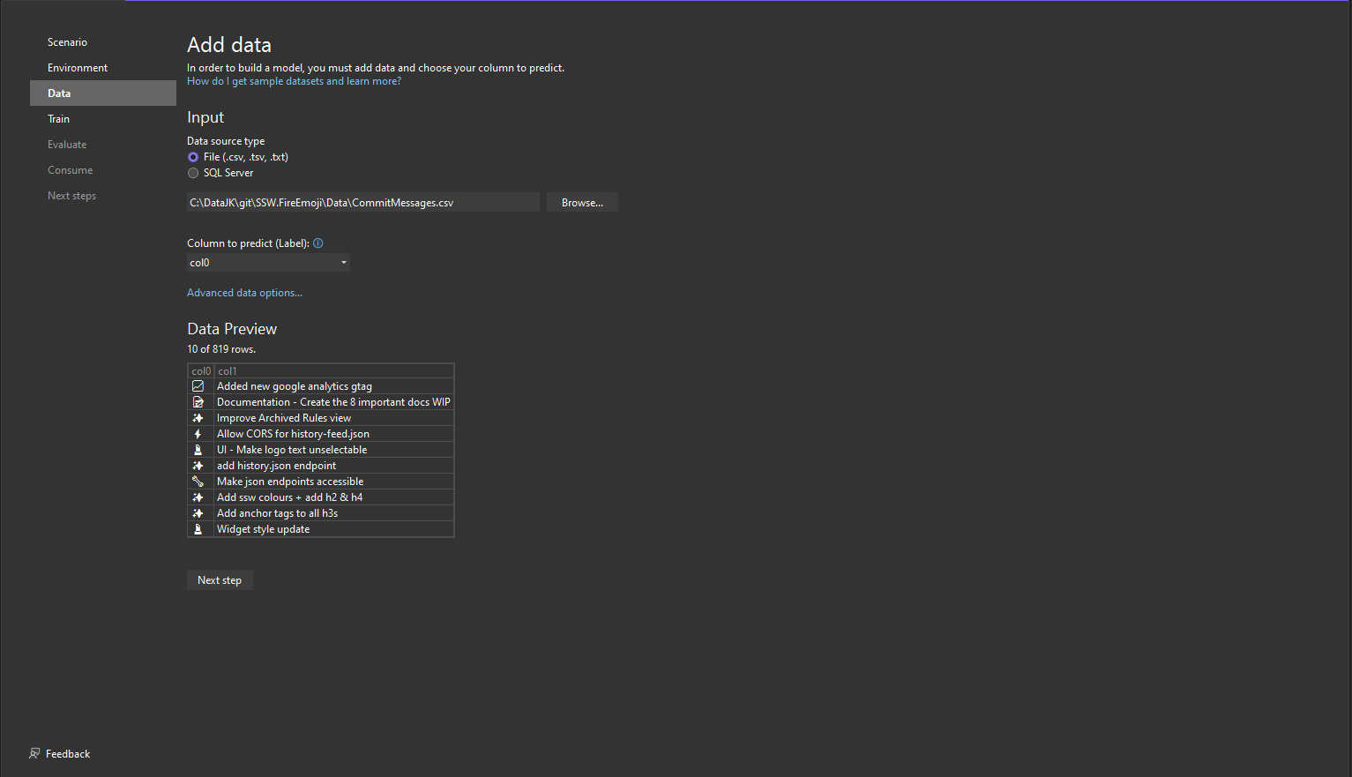
Notes:
Use https://github.com/SSWConsulting/SSW.FireEmoji/blob/main/Data/CommitMessages.csv

Slide 21
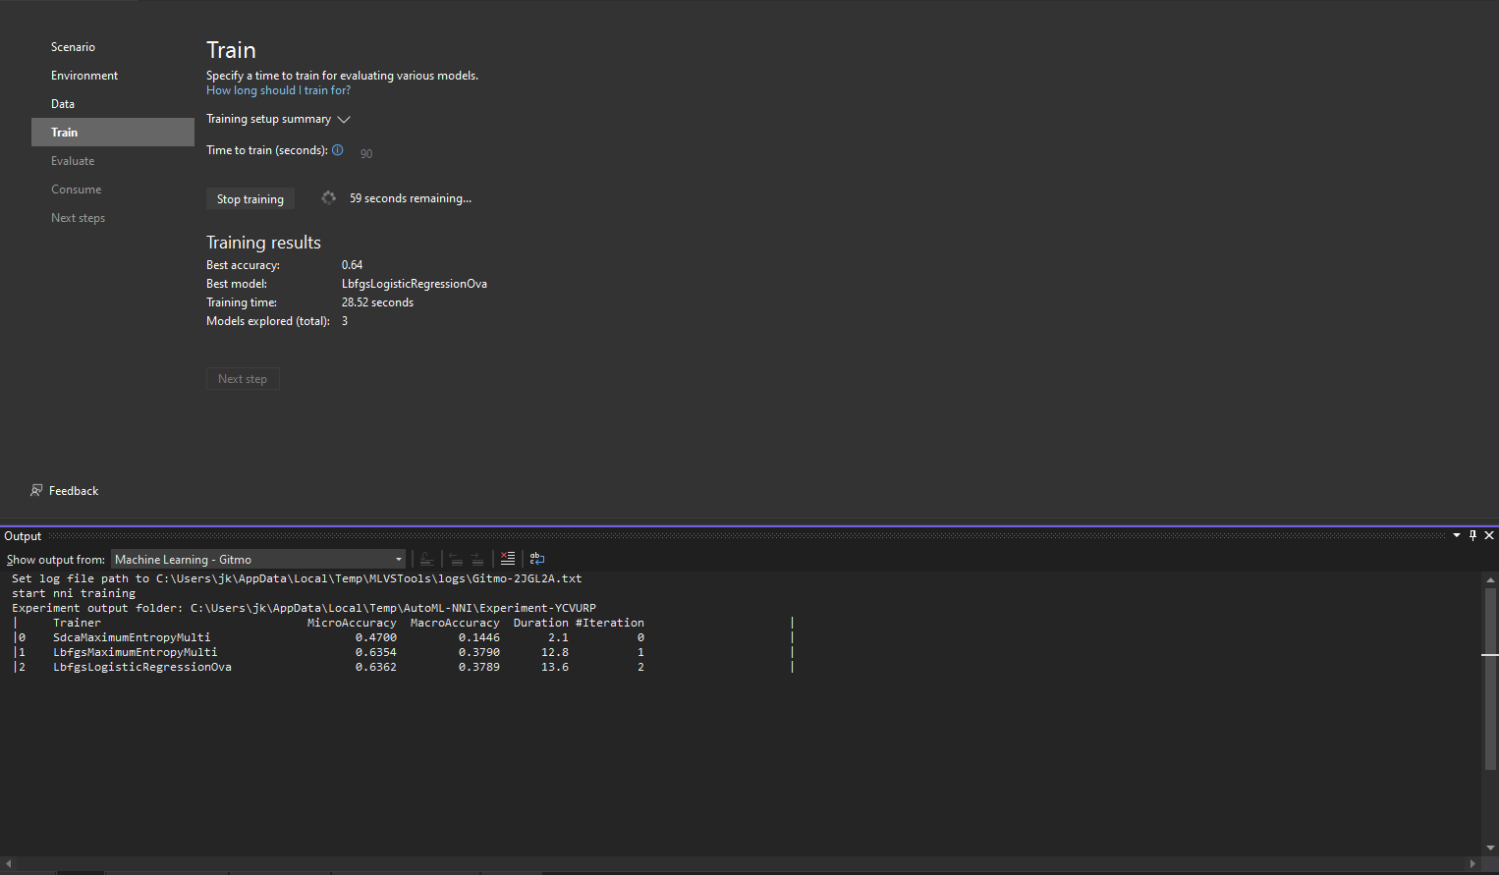

Slide 22
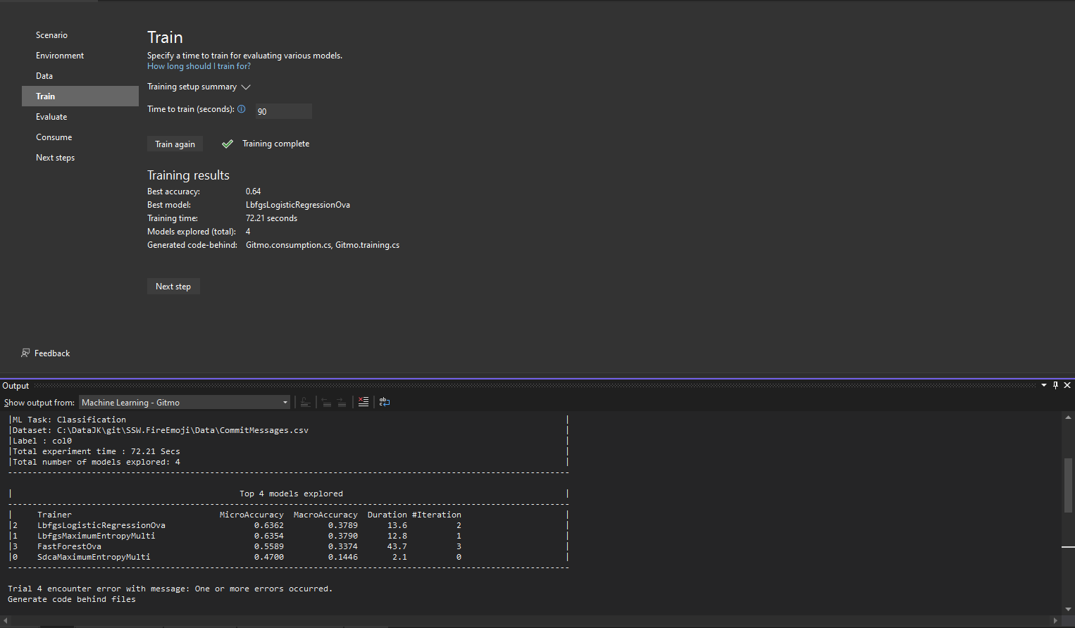

Slide 23
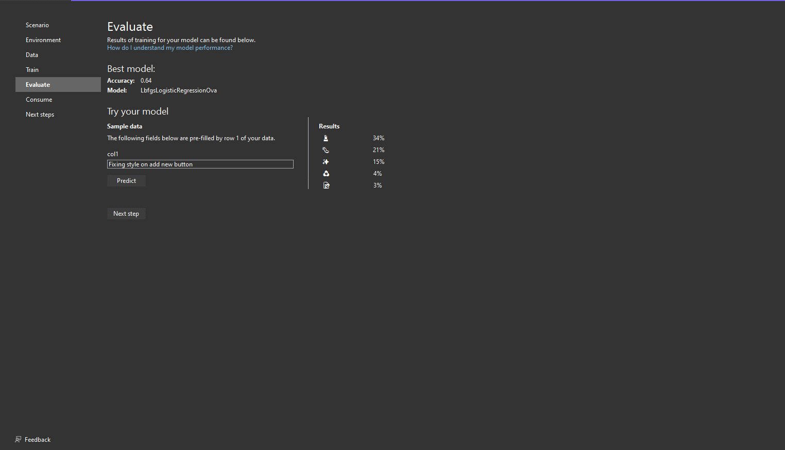

Slide 24
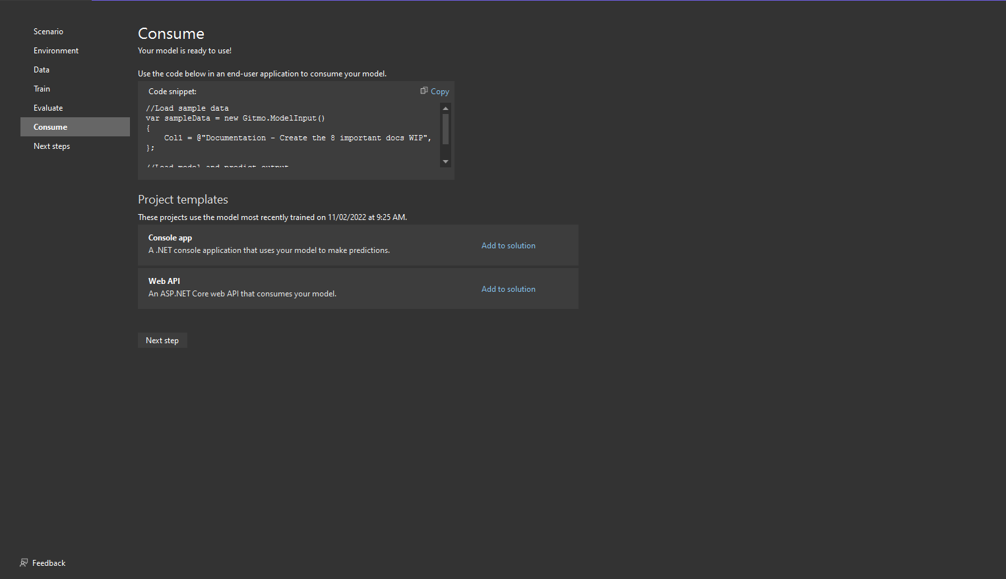

Slide 25


Ready for the Future
✅ Unlimited gitmoji support
✅ Contextual ML models
Azure DevOps/GitHub tasks
Email subjects
Socials (Twitter messages)
Many more

Slide 26
Summary
Get the perfect gitmoji for every commit
Quick and easy to use (few clicks)
Paste from FireEmoji straight into git
User suggestions generate consistent improvement
Notes:
Tip: Just copy your Agenda slide and change one word (From Agenda to Summary)

Slide 27
Summary
1. What is Machine Learning (90 seconds edition)
2. What is ML.NET Model Builder
3. Clever gitmojis - SSW.FireEmoji 🔥

Slide 28
Links
ML.NET Model Builder
dotnet.microsoft.com/en-us/apps/machinelearning-ai/ml-dotnet/model-builder
SSW.FireEmoji
www.fireemoji.io/
SSW.FireEmoji GitHub
github.com/sswConsulting/ssw.fireemoji
Gitmoji.io
gitmoji.io

Slide 29

Thank you! info@ssw.com.au www.ssw.com.au Sydney | Melbourne | Brisbane | Newcastle
Notes:
Note: You should say “thank you” and then pause for 4-5 seconds… to give the audience time to applaud!
https://www.ssw.com.au/rules/do-you-finish-your-presentation-with-a-thank-you-slide

Slide 30
Questions? info@ssw.com.au www.ssw.com.au Sydney | Melbourne | Brisbane | Newcastle
Notes:
Note: You should pause for applause here!
https://www.ssw.com.au/rules/do-you-finish-your-presentation-with-a-thank-you-slide

